Slide 1
Mechanical Keyboards
Your next hobby

Slide 2
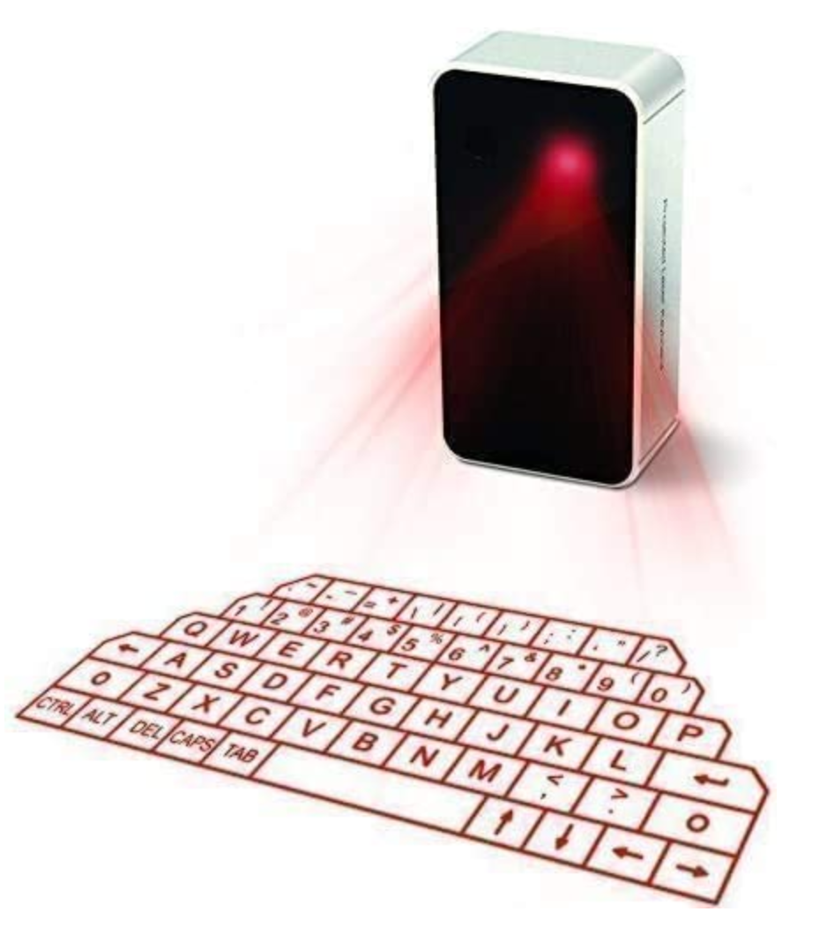
‘Mechanical’ keyboard?
Aren’t all keyboards mechanical?
Non-Mech
Membranes under keys, have a squishy feeling.
No real tactile feedback.
Generally lack support for n-key rollover.
Mech
Mechanical switches under each key.
Often combined with other higher quality parts; cases, keycaps, customized via firmware.

Slide 3
What’s it made of?

Slide 4
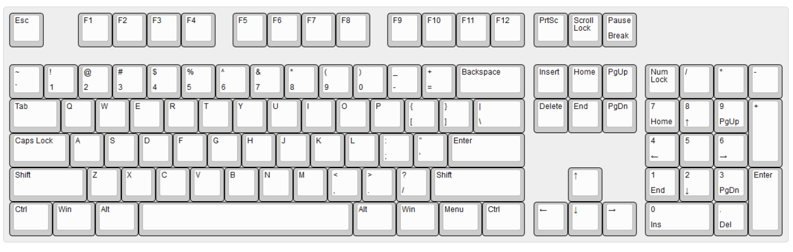
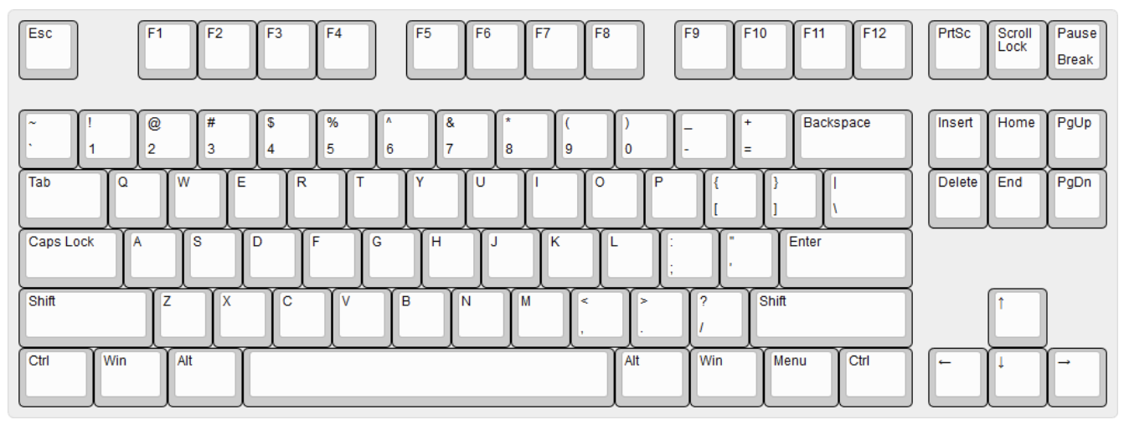
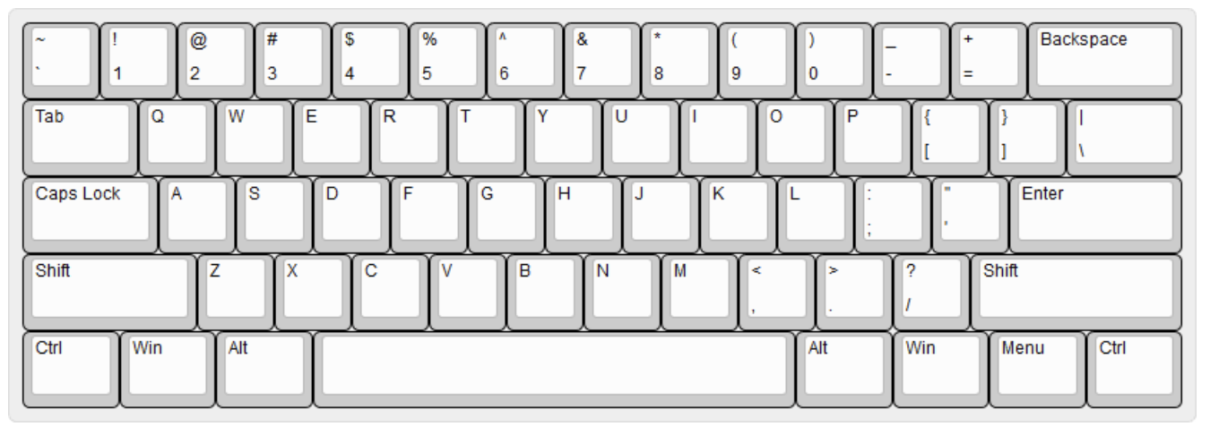
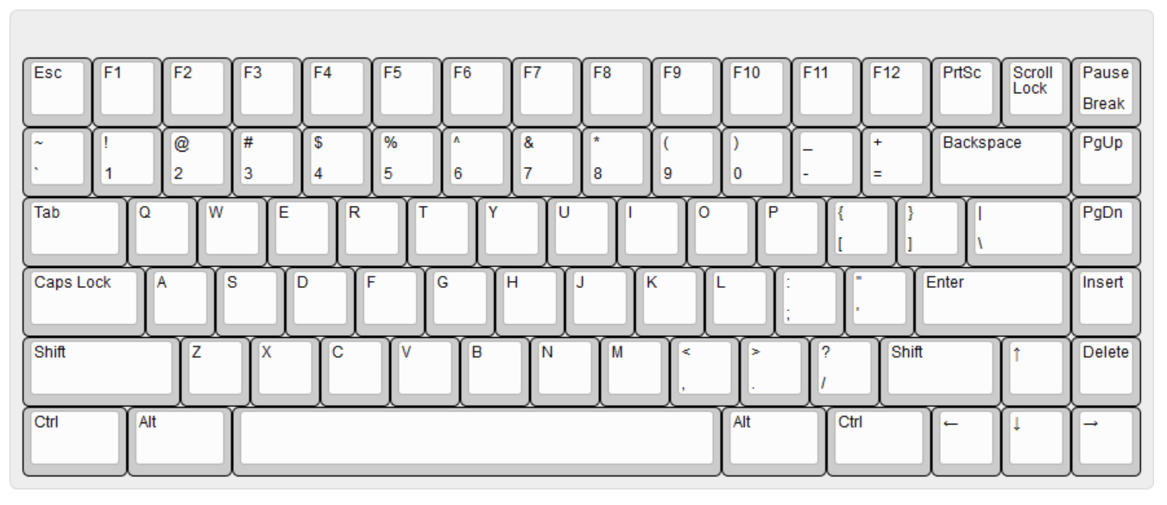
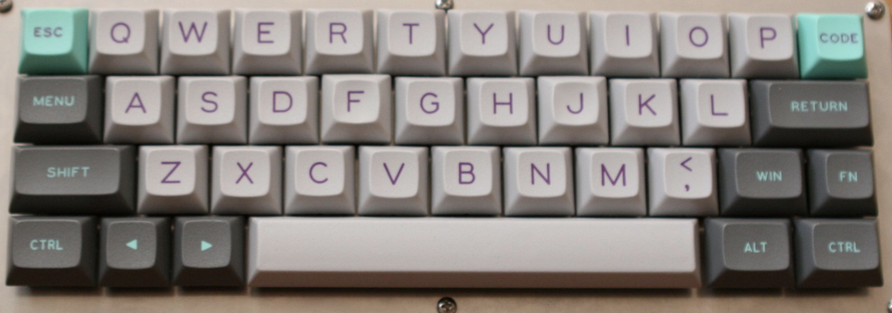
Form Factors
Full-size
Tenkeyless/TKL/80%
60%
75%
40%

Slide 5
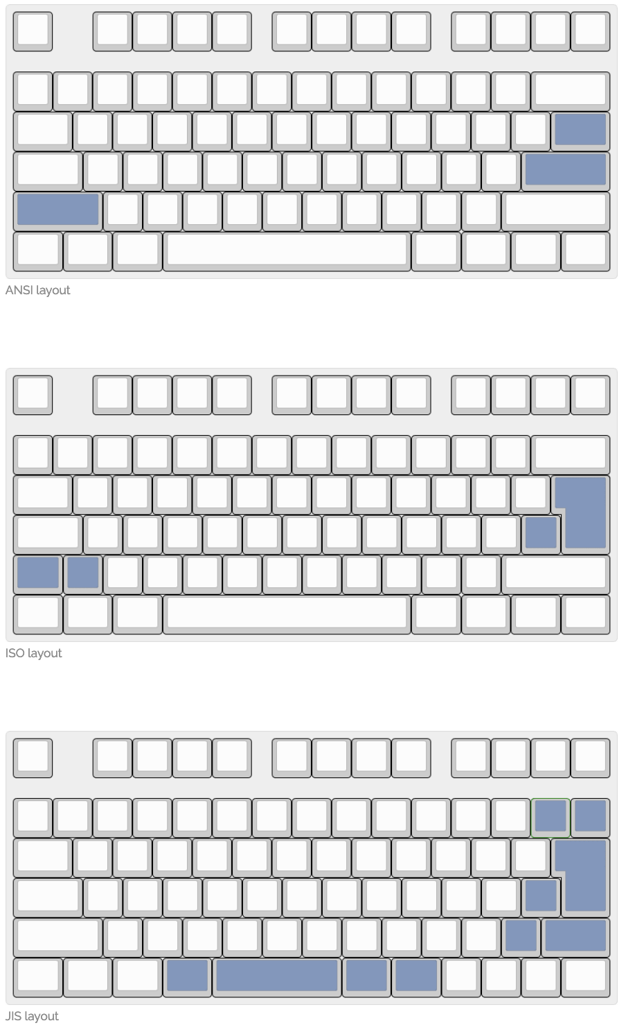
Layouts

Slide 6
Switches
Components
Upper and Lower Housing
Stem
Metal contacts
Spring
Cherry MX is a common style
Distinguished by color

Slide 7
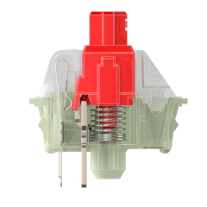
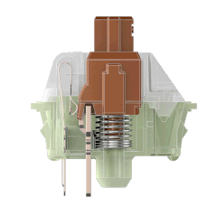
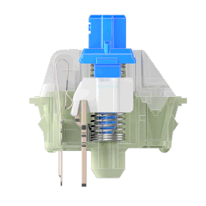
Switch Types
The keyboard feel & sound
Linear
smooth, quiet, no ‘bump’, faster feel, bottom out.
Tactile
a bump midway through stroke / actuation-point
Clicky
a bump & click midway through stroke / actuation-point
Others…
Buckling Spring, Alps, Topre

Slide 8
Case & Plates
Cases come in plastic, acrylic, aluminum, brass, etc.
Plates come in plastic, aluminum, brass, steel, etc.

Slide 9
PCB
Solder PCB
Match the form factor
USB I/O / Bluetooth
uController - Firmware (QMK)
Hot-Swap PCB
no soldering, swap switches in/out
Standard PCB w/ SMT
solder switches with some options on placement
Through hole or no PCB
no SMT, harder to find
hand-wired
Hot-Swap Socket (bottom)

Slide 10
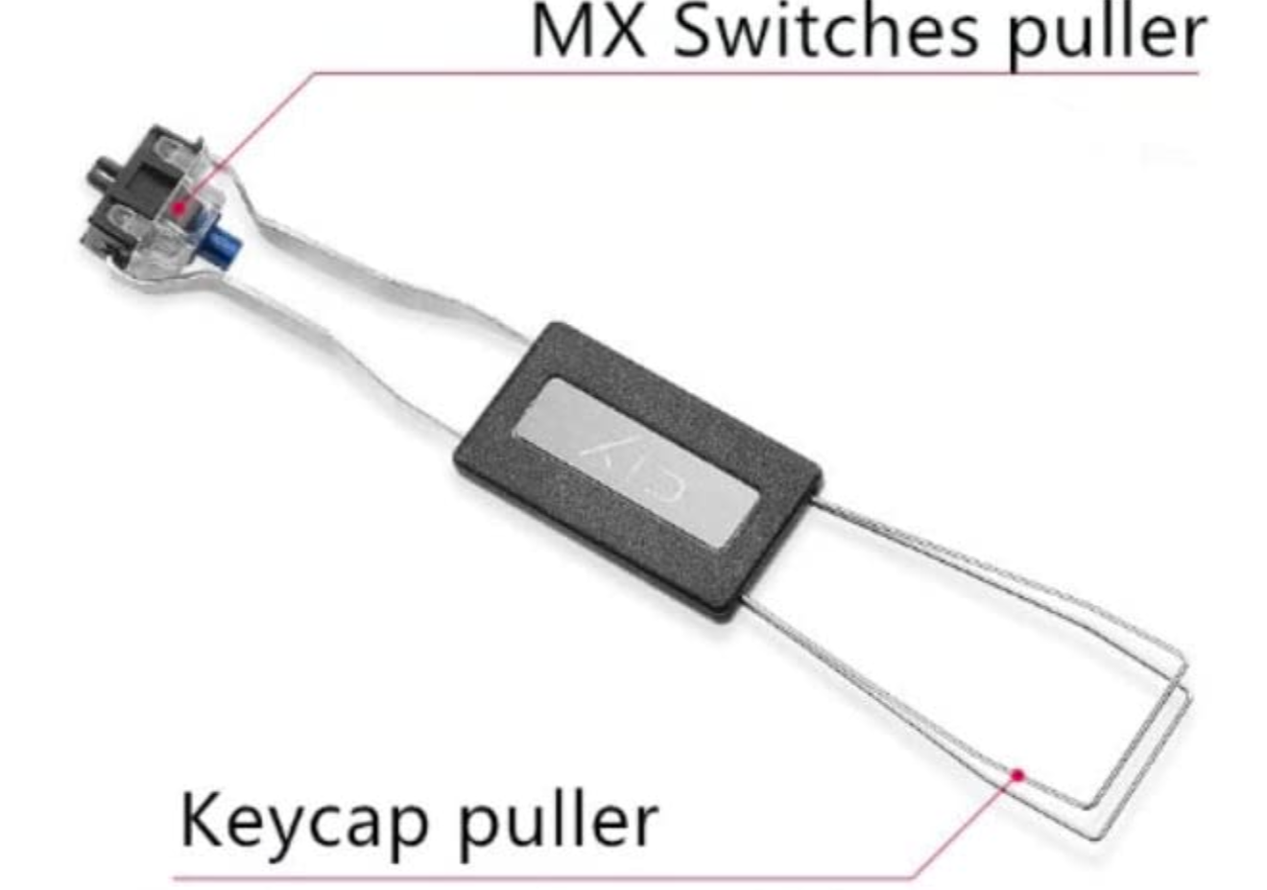
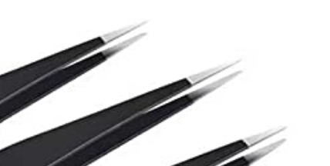

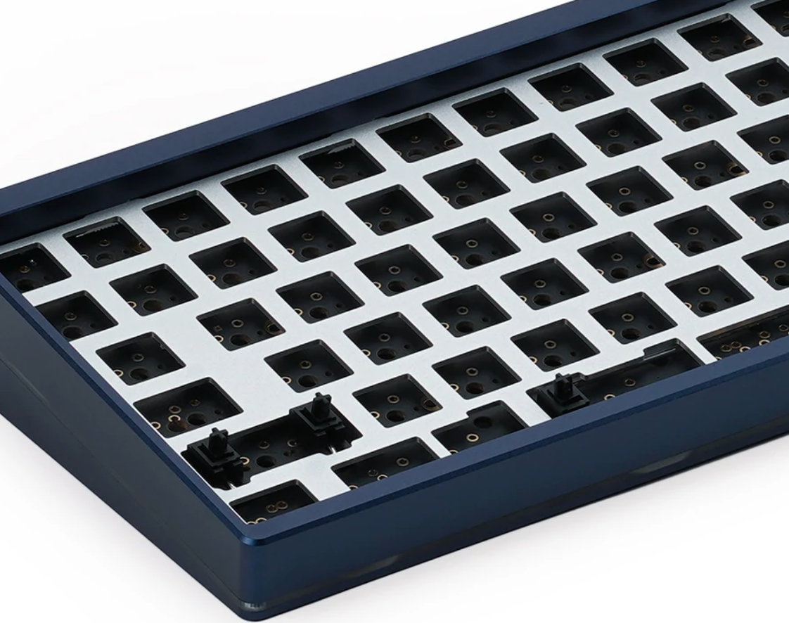
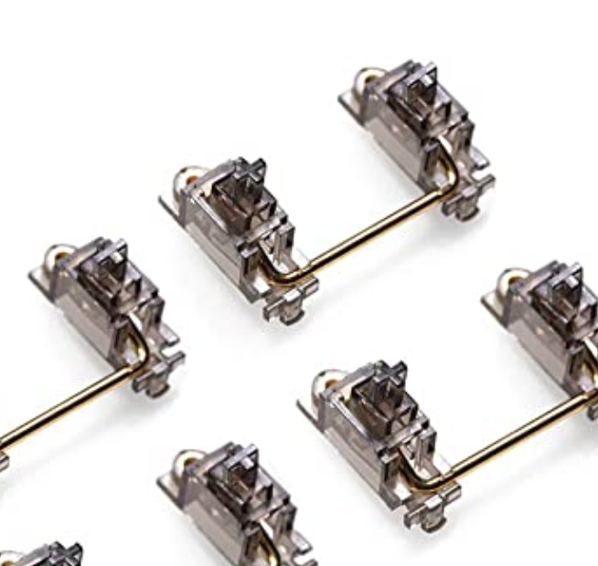
Build Tools / Parts
Solder Style
Hot-Swap Style
Screwdriver Set
Soldering Station
Tweezers
Keycaps
Case/PCB/Plate
Switches
Switches
Stabilizers
Keycaps

Slide 11
Keycaps

Slide 12
Appendix

Slide 13
Switch Properties
Kalih Speed Silver
Cherry MX Blue
Operation Force
It's how hard you have to press the key. Operating force is measured in centinewton (cN) or gram-force (gf). 1 gf is equal to 0.98 cN, so they are almost equivalent. You can say that a switch with 0.50 cN has 0.50 gf.
Activation Point
It is the point where a keypress is recognized by the keyboard. This is measured in millimeters. It is also known as Actuation Point or Operating Position.
Total Travel Distance
It’s the distance your keycap travels until it hits the upper housing of the switch. It’s basically the distance until you bottom out. This is also measured in millimeters.
Tactile Position
Tactile position is where you feel the bump on tactile and clicky switches. On linear switches, there’s no tactile position.
Reset Point
Reset position is the distance at which the key is deactivated when released.
Switch | Feel | Activation Force (cN) | Bottom Out Force (cN) | Activation Point (mm) | Travel Distance (mm)
MX Red | Linear | 37 | 54 | 2 | 4
MX Black | Linear | 55 | 75 | 2 | 4
MX Dark Grey | Linear | 80 | 110 | 2 | 4
MX RGB Nature White | Linear | 55 | 65 | 2 | 4
MX Silent Red | Linear | 45 | 60 | 2 | 3.7
MX Silent Black | Linear | 60 | 80 | 2 | 3.7
MX Brown | Tactile | 45 | 55 | 2 | 4
MX Clear | Tactile | 50 | 85 | 2 | 4
MX Light Grey | Tactile | 67 | 110 | 2.2 | 4
MX Blue | Clicky | 55 | 60 | 2 | 4
MX Green | Clicky | 65 | 90 | 2 | 4
MX White | Clicky | 60 | 82 | 2.2 | 4

Slide 14
References
https://aaronbush.github.io/keyboards/builds/first.html
https://wiki.geekhack.org/index.php?title=GeekHackWiki
https://blog.wooting.nl/the-ultimate-guide-to-keyboard-layouts-and-form-factors/
https://www.keychron.com/blogs/news/keyboard-size-layout-buying-guide
https://techwithtech.com/mechanical-keyboard-parts/
https://www.daskeyboard.com/blog/mechanical-keyboard-guide/
https://www.cherrymx.de/en/

